Slide 1
In silico assessment of insecticidal activity of Thymus algeriensis and T. numidicus
MedForum 2021 CIHEAM
LEBBAL Aissa 1, RAHAL Khaled 1, LEBBAL Salim *1
1 Faculty of Nature and Life Sciences, University of Khenchela, Algeria
* Speaker and corresponding author: email salimlebbal@gmail.com

Slide 2
Introduction
Crop losses due to harmful organisms (pests) can be substantial and may be prevented, or reduced, by crop protection measures (Oerke, 2006). The use of chemical pesticides has numerous advantages. However, in addition to their direct costs, they have numerous indirect costs, which they include poisoning of farm workers, and the deleterious effects on non-target organisms (Lamichhane et al., 2016). There is a growing interest given these last years to biopesticides, for a sustainable development. Biopesticides are a group of naturally occurring, often slow-acting protecting agents that are usually safer to humans with minimal residual effects to the environment than conventional pesticides (Hassan Adeyemi, 2010).
In nature, essential oils play an important role in the protection of the plants as antibacterials, antivirals, antifungals, insecticides (Bakkali et al., 2008).
Thymus algeriensis and T. numidicus are endemic species to Algeria (Nikolić et al., 2014 ; Kabouche et al., 2005).
One application of molecular docking is to design pharmaceuticals in silico by optimizing lead candidates targeted against proteins (Thomsen & Christensen, 2006). Thus, this work aims to assess the virtual effectiveness of the T. algeriensis and T. numidicus’s EO compounds against insects.

Slide 3
Materials and Methods
The main objective of this paper is to study the interactions between two molecules: a receptor (Drosophila melanogaster Acetylcholinesterase) and a ligand by molecular docking, in order to elucidate the potential insecticidal activity of seven compounds of T. algeriensis and T. numidicus essential oils
A typical docking workflow
(Morris & Lim-Wilby, 2008)

Slide 4
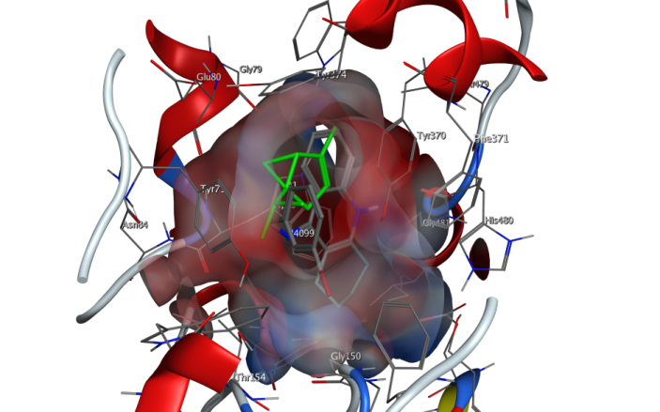
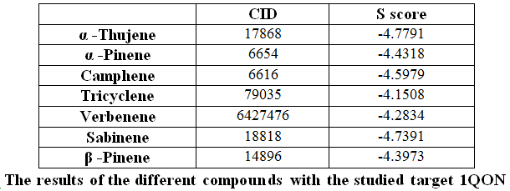
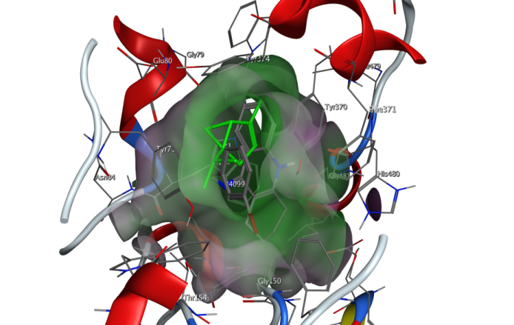
Results and discussion
The docking procedure allows the generation of a list of complexes representing the favorable association modes between the ligand and the macromolecular receptor. In general, α –Thujene gave the best affinity result with 1QON
Thank you

