Slide 1
Relationship between litter size and body linear type traits in local goat population raised under arid conditions
MedForum 2021 CIHEAM
Atoui Ahlem*1, Laroussi Aicha2, Abdennebi Moldi1, Ben Salem Farah1, Najari Sghaier1
1 Institute of Arid Regions, Médenine. 4119. Tunisia. Faculty of sciences (F.S.G) Gabés, Tunisia. University of Gabés.
2 National Agronomic Institute of Tunisia, University of Tunis, Tunisia.

Slide 2
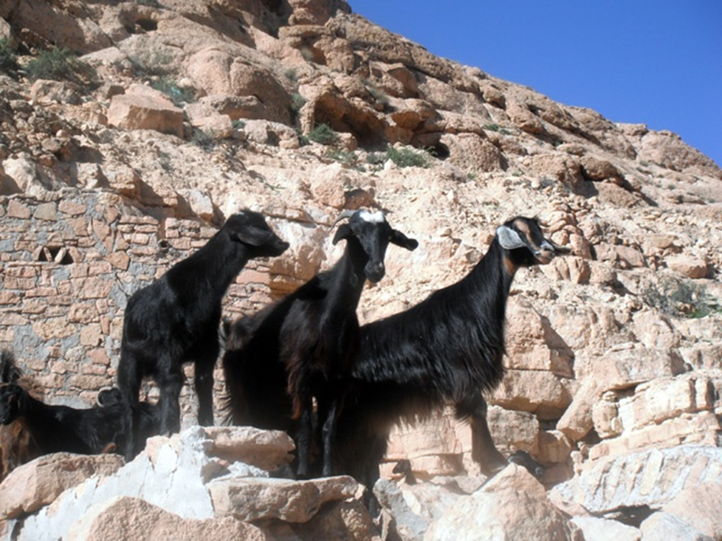
MOTIVATION
Goat production based on local breeds adapted to the harsh conditions in the Southern region of Tunisia will be economically sustainable as long as benefits can be kept at reasonable levels. Benefits depend largely on the productivity of the animals, being the litter size at birth a key component.
NEED TO DEVELOP SELECTION SCHEMES TO IMPROVE SUSTAINABILITY Body linear measurement during pregnancy.
Explore which traits influence the litter size at kidding of local goats.

Slide 3
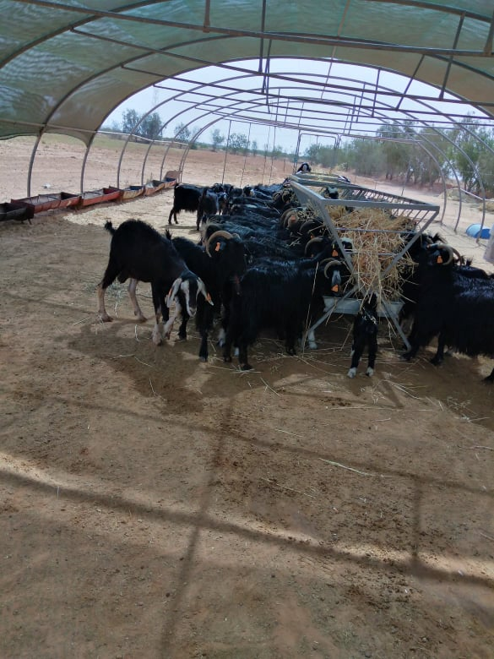
MATERIAL AND METHODS
DATA: Records of 85 goats were used for this study. Data taken at experimental farm “ElGORDHAB. Five phenotypic variables measured included: Body length (L1), Body weight (BW), Heart girth (L2), Punch girth (L3), Withers height (L4) and Litter size (LSB).
STATISTICAL ANALYSIS: The significance of the phenotypic variables was tested using the ANOVA procedure. Simple correlation coefficients between body measurements traits with litter size were calculated.
RESULTS AND DISCUSSION
Table 1. Basic statistics for female litter size at kidding and body linear traits of Tunisian local goats.
Variable | Mean | Minimum | Maximum | SD | CV (%)
LSB (kids born) | 1.31 | 1 | 3 | 0.45 | 34.35
L1(cm) | 64.71 | 30 | 80 | 6.33 | 9.78
L2(cm) | 62.54 | 57 | 70 | 2.55 | 4.07
L3(cm) | 75.23 | 68 | 79.50 | 3.20 | 4.25
L4(cm) | 61.86 | 18 | 98 | 5.66 | 9.15
BW (kg) | 24.27 | 19.25 | 32 | 5.20 | 21.43
3

Slide 4
LSB is similar to other indigenous goat populations in Africa but lower than selected breeds.
Small adult size is a characteristic of most breeds raised under arid conditions.
Table 2. Correlation between linear traits and LSB in local goat population.
 | LSB | L1 | L2 | L3 | L4 | BW
LSB | 1 | 0.51 | 0.54* | 0.63** | -0.22* | 0.67*
L1 |  | 1 | 0.90 | 0.91* | 0.91* | 0.93**
L2 |  |  | 1 | 0.95** | 0.83* | 0.93*
L3 |  |  |  | 1 | 0.92* | 0.92**
L4 |  |  |  |  | 1 | 0.92**
BW |  |  |  |  |  | 1
The most body linear parameters were significantly higher (p<0.01) in goats bearing multiple foetuses than the goats bearing a single foetus during pregnancy.
The BW present the high correlation with LSB compared to all other body measurements for discriminating between goats carrying one or two fetuses.
Conclusion
The BW, the L2 and the L3 parmeter may be useful tools for the difference between the goats carrying multiple foetuses and the goats carrying single foetus and thus achieving more economic benefits out of multiple births by taking special care of females carrying multiple foetuses.

