Slide 1
Soil Biostimulant Application on Tomato Seedlings
MedForum 2021 CIHEAM
Bruna Aline Vacelik ¹, Tefide Kizildeniz ², Marcelle Michelotti Bettoni *¹
1 Universidade Tuiuti do Paraná- - Rua Rua Sydnei Antônio Rangel Santos, 238 - Santo Inácio, Curitiba - PR, 82010-330, Curitiba-PR, Brazil
2 Niğde Ömer Halisdemir University, Faculty of Agricultural Sciences and Technologies, Biosystem Engineering Department, 51240, Niğde, Turkey
* Spekear and Corresponding Author: marcelle.bettoni@utp.br

Slide 2
INTRODUCTION
The cultivation of tomato is an activity with great economic potential in the world as well as in Brazil, that is cultivated around 62,000 hectares in Brazil, with 4.5 million tons harvested in 2018 (IBGE, 2018)
Use of tomato cultivars that are more adapted to the climate and the region, and more resistant to certain pests and diseases, such as Justyne® hybrid (TAKII, 2018).
Use of fertilizers with less environmental impacted components such as humic substances, during agricultural practices can result in higher agricultural productivity combined with higher quality.

Slide 3
INTRODUCTION
Humic substances can be considered as "biostimulants" of plants for their growth promoting action due to increased roots and greater absorption of nutrients.
The soil application of humic acid is stimulated photosynthesis, respiration, protein synthesis and enzymatic activities in the cultivars.
However, its correct application period on tomato seedlings is not well defined for optimizing the vegetative growth and future productivity with definition of best concentration of it.
Therefore, the aim of this study was evaluate the influence of soil biostimulant called Bio Humate®, based on humic substances, in the vegetative development of Justyne® hybrid tomatoes grown in the greenhouse.

Slide 4
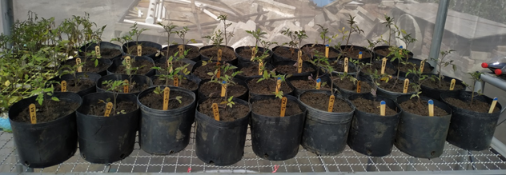
Materials and methods
The experiment was carried out in a greenhouse at the Tuiuti do Paraná University;
Commercial soil biostimulant Bio Humate® to three replicates of Justyne® hybrid tomatoes per treatments; design was completely randomized with 4 doses of the product x 2 evaluation dates
At 42 and 56 days after transplanting (DAT) with application on every 14 days, starting at 7 DAT.

Slide 5
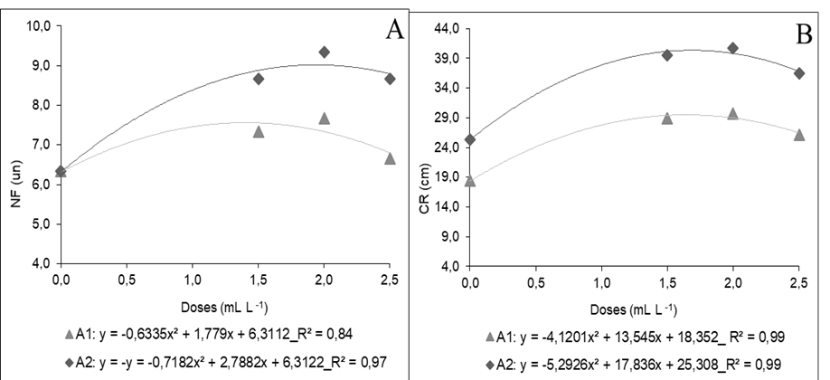
Results and discussion
(a) increases in number of leaves and root length (b)
(C) INCREASES IN ROOT VOLUME AND LEAVES FRESH MASS + ROOT FRESH MASS (D)

Slide 6
Results and discussion
The soil application of the Bio Humate® biostimulant demonstrated in the best results of application in fresh vegetative parts while chlorophyll contents are the lowest at 56 DAT.
In conclusion, the optimal utilization of Bio Humate® to hybrid tomato seedlings are 56 DAT for vegetative growth even the chlorophyll content is lowest.

Slide 7
Conclusion
The application of soil biostimulant Bio Humate® fertilizer had a positive effect on the vegetative development of tomato Justyne® hybrid seedlings growth in the greenhouse.
The further application of soil biostimulant Bio Humate® fertilizer is required until the harvesting period of tomato fruits in order to obtain final results.

Slide 8
Soil Biostimulant Application on Tomato Seedlings
MedForum 2021 CIHEAM
Bruna Aline Vacelik ¹, Tefide Kizildeniz ², Marcelle Michelotti Bettoni *¹
1 Universidade Tuiuti do Paraná- - Rua Rua Sydnei Antônio Rangel Santos, 238 - Santo Inácio, Curitiba - PR, 82010-330, Curitiba-PR, Brazil
2 Niğde Ömer Halisdemir University, Faculty of Agricultural Sciences and Technologies, Biosystem Engineering Department, 51240, Niğde, Turkey
* Spekear and Corresponding Author: marcelle.bettoni@utp.br

