Slide 1
Panorama of the apple sector in Lebanon: structure and constraints
MedForum 2021 CIHEAM
Hala ABDALLAH*, Selma Tozanli **, Fatima EL Hadad Gauthier ***, Salem Darwich****
^{1 Hala Abdallah SupAgro/MOISA.}
2 Selma Tozanli Former Researcher at CIHEAM-IAMM
3 Fatima El Hadad Gauthier Mediterranean Agronomic Institute of Montpellier (CIHEAM-IAMM) Montpellier France
3 Salem Darwich Faculty of Agronomy, Lebanese University
* Speaker: Hala Abdallah, email: abdallahhala@gmail.com

Slide 2
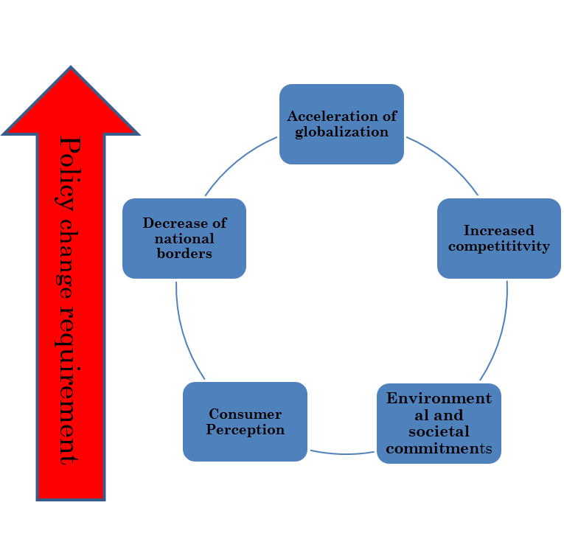
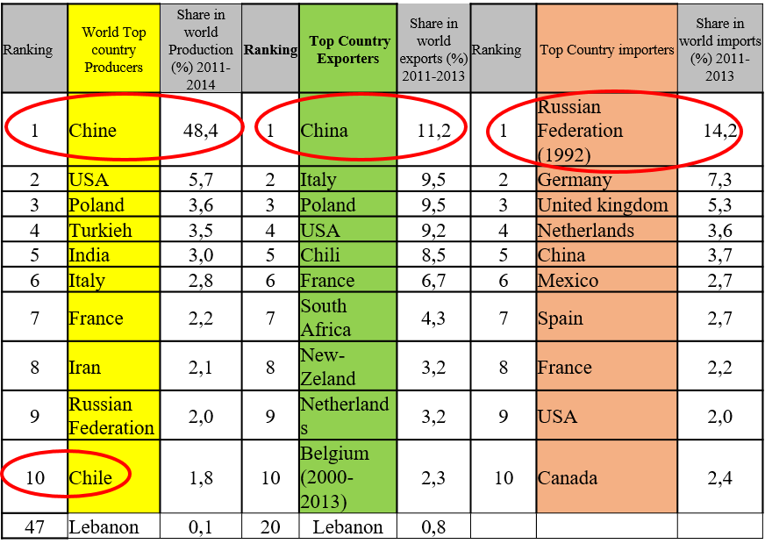
Introduction World context on the country competitivity of apple trade
Table : Worldwide country positionning
Source: ttp://www.fao.org, 2018; UN Trade map, 2018
.

Slide 3
Materials and methods/context and structure
The combination of these two tools was completed by "snowball effect.
Our sample was constructed on the basis of 3 classes, based on farm sizes (<1ha; 1ha <between <4.5 ha;> 4.5 ha), covering around 10.96% of the total area of apple holdings in Mount Lebanon.

Slide 4
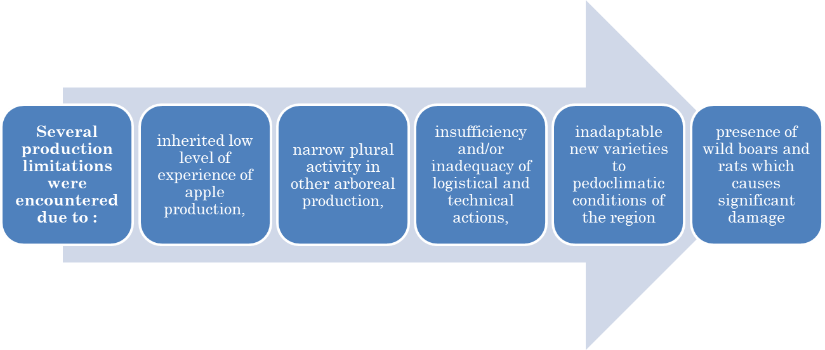
Results (1/4) and discussion
The technical conditions at the Production level
The cultivation system is traditional
The difficulty in the farmer’s conviction to adopt and adapt to MoA technical itinerary (GAP, IP…).
The use of inputs by the small farmers are negatively impacted by the high cost of working force and the high prices of chemicals

Slide 5
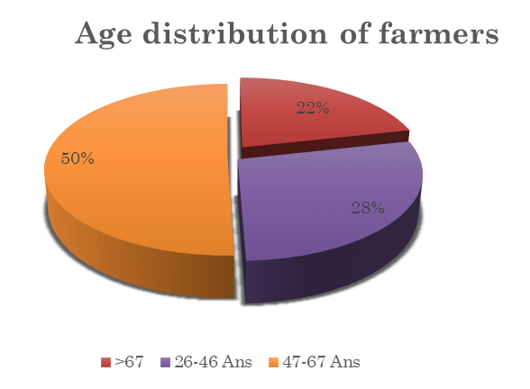
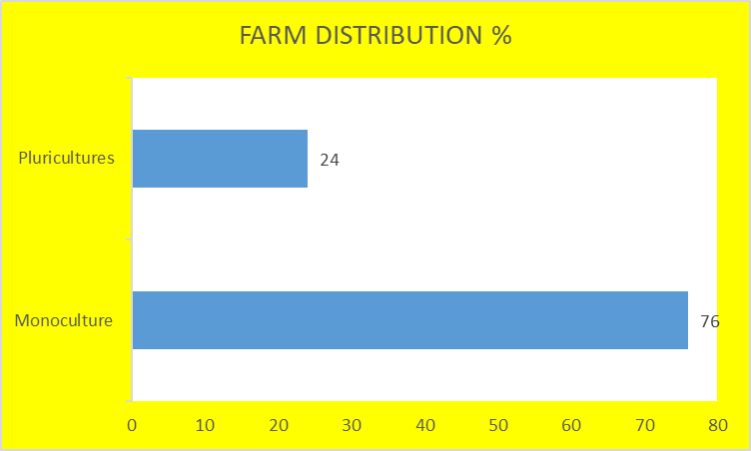
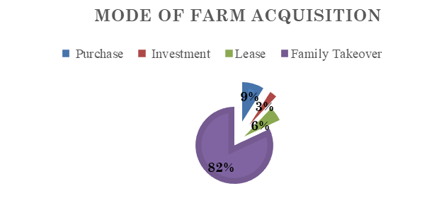
Results (2/4) Status of apple farmers
(Source: Author preparation, 2017).

Slide 6
RESULTS 3/4 Investments and financing status
The share of family labor in the total permanent workforce is around 50% for all farm sizes.
Investments in production and farm equipments are generally rudimentary at the farm. The majority of the farmers surveyed opted for 100% self-financing.
Disparity between the terms/conditions of available loans and farmers’ capacities
Farmer’s indebtedness/ delay to get profits of their resources
Limitations to
access to credits:

Slide 7
RESULTS 4/4 limitations of Extension, Training and Research
Extension
Research
Ministry of Agriculture
Training
Agricultural research is not applied in the extension process, with the exception of subject remedies against apple diseases

Slide 8
Proposed Recommendations and Conclusion
Proposed Recommendations: To foster the emergence of cooperatives and or the coordination of all actors in a cluster /promote Company Networks/ Solve the problem of access to credits
The main constraints of the apple value chain structure can be resumed in two main headings: structural constraints arising from investment and financing problems and institutional constraints
The analysis was limited to only one region and one crop of the country with little influence from the international policies.
our work opens up three promising research perspectives:
To respond to the government's policy of adopting sustainable development for the coming years.
To analyse the articulations between the different actors as an “industrial organization" analysis of the sector.
To foster the effects of niche markets; biological production, and exports

