Slide 1
Geographical Indications and Sustainable rural development: possible paths from PDO honey in Italy to Albania
MedForum 2021 CIHEAM
Antonio Caso¹, Simona Giordano²
^{1 Università di Bologna}
2 Università degli Studi di Bari Aldo Moro and Mediterranean Agronomic Institute of Bari (CIHEAM Bari)

Slide 2
Geographical Indications (GIs)
Connection between Geographical Indications (GIs) and economic benefits for rural areas.
GIs for Food products -> Important tool of intellectual and cultural property protection and considerable agricultural development factor.
European Union
Protected designations of origin (PDO) for agricultural products and foodstuffs, and wines
Protected geographical indications (PGI) for agricultural products and foodstuffs and wines

Slide 3
Geographical Indications (GIs)
EU and Rural development
Three keywords: endogenous, integrated and sustainable.
GIs represent a powerful marketing tool (reputation, guarantee of quality) and contribute to raising the economic value of agricultural products
UNIQUE IDENTITY
Lamy: Geographical Indications are a wealth multiplier; they play a fundamental role as a resource and a collective right which expressly belongs to communities becoming a “collective intellectual property”. Moreover, they encourage a more balanced distribution of wealth derived from the added value embedded in each product.

Slide 4
Protected Designations of Origin
Italy managed to develop three PDO-certified honey:
Miele della Lunigiana D.O.P.
Miele delle Dolomiti Bellunesi D.O.P.
Miele Varesino D.O.P.
Example of bottom-up rural development

Slide 5
PDO Honey in Italy
PDO Honey is produced and processed by Apis mellifera starting from the nectar of the flowers of each territory and has peculiar qualitative characteristics. The chemical-physical, organoleptic and melisso-palynological characteristics, in fact, are closely linked to the typical flora of each production environment. According to the different botanical species that bloom gradually during the production period and the consequent floral origin, different types of Honey are obtained, according to production protocols.

Slide 6
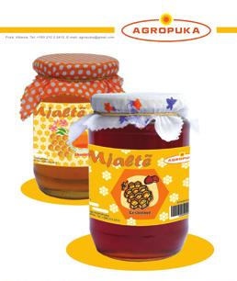
Honey in Albania
In Albania, honey production is currently concentrated in the north, especially in the areas of Zadrima, Tropojë, Reç, and Pukë. Weaknesses in the production relate to the fragmentation of production and the lack of adequate communication routes. Nevertheless it is already possible to find this type of honey in the markets of Tirana or Durrës. In the forests of Tropojë, it is also possible to find the so-called "chocolate honey", a chestnut honey characterized by a particularly dark colour and a marked sweet taste, mainly produced in June. The honey from Pukëdraws its essence from the different herbs of the area.

Slide 7
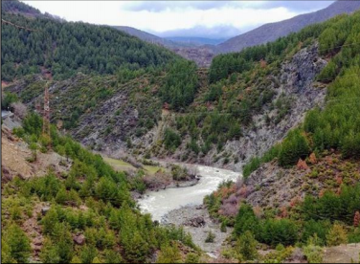
Conclusions
GIs play a wide array of functions and the scenario is diversified; in the northern part, the research and the institution of PDO and PGI marks are more advanced, above all thanks to local NGOs and associations which have already established a sort of Disciplinary of Production for some products, such as chestnuts and honey. Broadening the scope of PDO best practices in Italy represents an important and interesting tool to assess the potential of the described sector in Albania, and to draw a road map towards the reach of SDGs at local level.

Slide 8
Q&A
Thank you for your attention!

