Slide 1
Factors influencing innovative circular business models in the Mediterranean olive oil value chain
MedForum 2021 CIHEAM
I. Radić *¹, M. Donner ¹, T. Yatribi², Y. Erraach³, F. López-i-Gelats⁴, J. Manuel-i-Martin⁴, F. El Hadad-Gauthier⁵
¹ INRAE – French National Institute for Agriculture, Food and Environment, UMR MOISA, Montpellier, France
² ENA – National School of Agriculture of Meknes, Meknes, Morocco
³ INAT – National Agronomic Institute of Tunisia, Tunisia
⁴ University of Vic, Spain
⁵CIHEM-IAMM – Mediterranean Agronomic Institute of Montpellier, Montpellier, France
* Speaker and corresponding author: ivana.radic@inrae.fr

Slide 2
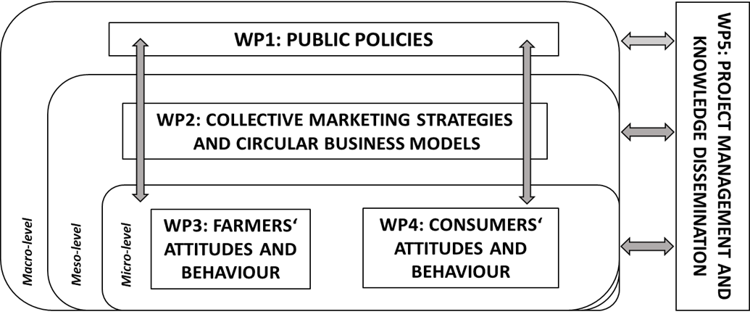
COLIVE PROJECT
The overall objective of the COLIVE project is to understand the socio-economic conditions and processes of the valorization of olive oil, waste and olive by-products.

Slide 3
Circular economy & Circular business models
Circular economy is "a systemic approach to economic development designed to benefit businesses, society, and the environment. In contrast to the 'take-make-waste' linear model, a circular economy is regenerative by design and aims to gradually decouple growth from the consumption of finite resources" (The Ellen McArthur foundation)
Circular business models are a subcategory of business models, which incorporate circular economy principles as guidelines, aiming to fully close product or material loops proposing the creation of value from waste or providing functionality instead of products (Bocken et al., 2019, 2014; Donner, Gohier and de Vries, 2020)

Slide 4
Drivers and barriers for circular business models
Drivers for successfully implementing circular business models (Tura et al, 2019)
Resource scarcity and opportunity for waste reduction and decreasing costs
Environmental regulations
Social drivers
Institutional factors
Technological development
Supply-chain related drivers
Barriers for implementing circular business models (Guldmann and Huulgaard (2019) :
barriers at the market and institutional level
barriers at the value chain level
barriers at the organizational
barriers at the employee level
Barriers and success factors specific for agriculture context (Donner et al, 2021):
technical and logistic
economic-financial and marketing
organizational and special
institutional and legal
environmental factors
social and cultural factors

Slide 5
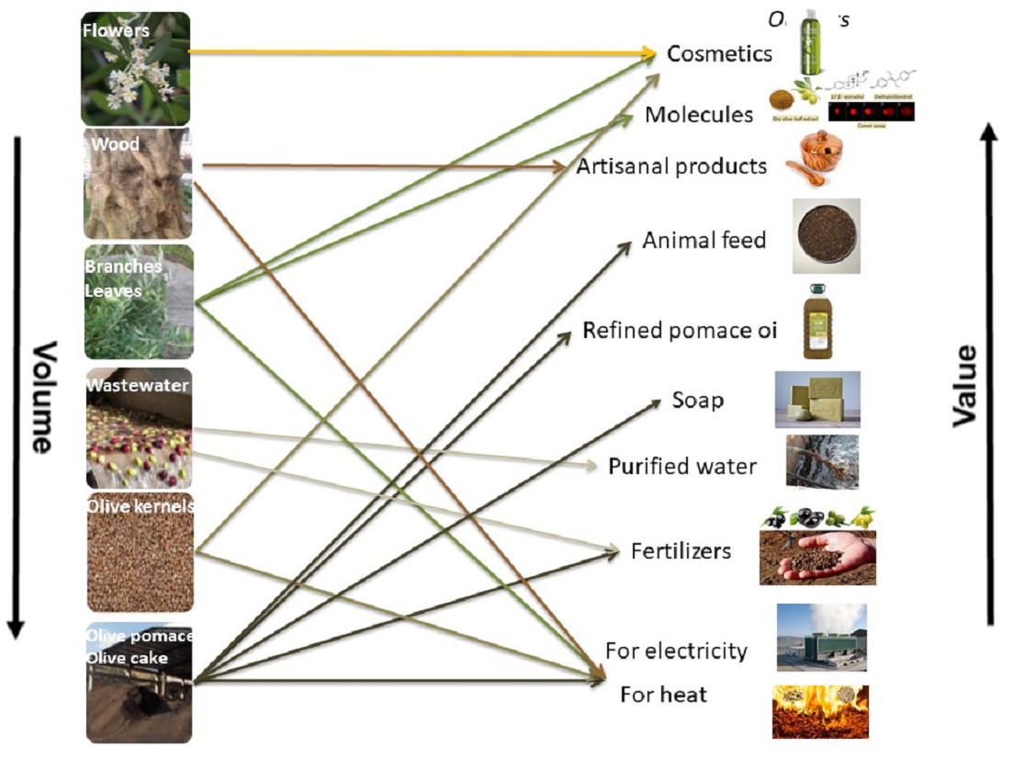
Olive sector in the Mediterranean
Nearly 10 million hectares of plantation and more than 2,5 million tons of olive oil per year in Europe and Africa (Vilar & Pereira, 2018)
The production of olive oil
generates different wastes
(wood, branches, leaves)
and by-products
(olive pomace, olive mill wastewater, olive stones)
in huge quantities (Roselló-Soto et al., 2015)
Source: Donner & Radic (2021)

Slide 6
Objective & Methodology
The objective of this work was to understand the drivers and barriers influencing the transition towards circular business models valorising olive waste and by-products (for food and non-food applications) in the Mediterranean area.
Ten case studies of entrepreneurial initiatives from the following Mediterranean countries: Tunisia (2), Morocco (1), France (1), Spain (1), Italy (2), Greece (3)
Semi-structured interviews with the responsible persons from the enterprises conducted
Field investigation in Tunisia
Qualitative content analysis

Slide 7
Success and hindering factors for implementation of circular business models
Internal success factors
Environmental concern
Knowledge about waste valorising technologies and markets
Long-term presence in the sector
External success factors
Availability of resources, legislation and subsidies
The role of consumers
Circular economy embeddedness in the territorial agenda
Internal hindering factors
Strong managerial implication
External hindering factors
Support from experts, policy and decision-makers (including financial support (external factor)
Waste management activities is recognized but not supported in practice
Collaboration between enterprises and research centres or universities is rather complicated

Slide 8
Concluding remarks and recommendations
A common feature observed among all the cases is the importance of territorial embeddedness, and care for the environment, both as a motivation and success factor
The enterprises are driven by a commitment to the environment, especially because of the unused high amounts and partly environmentally harmful residues
The most important barriers for businesses are external support and sustainable partnerships
More public-private partnerships or multi-stakeholder collaborations e.g. via joint projects are needed for further developing circular business models

