Slide 1
Natural saline pasture, a potentially sustainable feed alternative for lambs in Mediterranean coastal lands
MedForum 2021 CIHEAM
M. FRIHA*¹ , H. HAMDI¹, M. MOHAMED¹, M. JADLI¹,
L. MAJDOUB-MATHLOUTHI¹
¹ Institut Supérieur Agronomique de Chott-Mariem, 4042, Université de Sousse, Tunisie
* Speaker and corresponding author: email friha.mouna@gmail.com

Slide 2
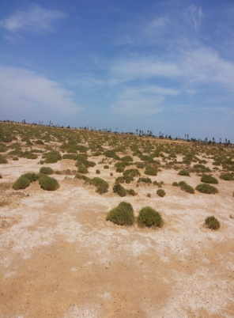
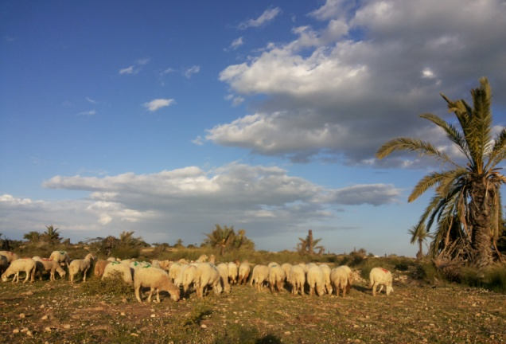
Introduction
Mediterranean areas
Saline lands Halophytes
Salts and anti-nutritional factors
Grassland-based sheep production
Livestock feeding
Animal’s growth
Botanic composition of natural saline pasture for two years
Growth and carcass performances of grazing female lambs

Slide 3
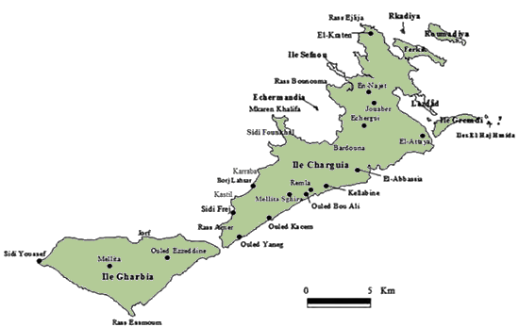
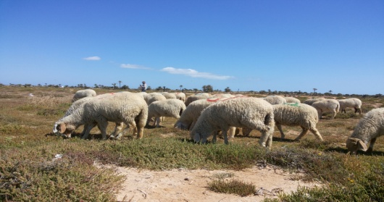
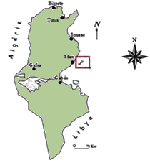
Materials and Methods
12 ha natural saline pasture
Spring (2018 and 2019)
Study area
Botanic composition
Female Queue Fine de l’Ouest lambs
Results and discussion
Effects of year on botanical composition and biomass of saline pasture
 | 2018 | 2019
Rainfall (mm) | 187.5 | 231.1
Halophytes shrubs (%) | 61.76 | 65.61
Coverage rate (%) | 66.11 | 82.60
Herbaceous biomass (tonne DM/ha) | 0.702 | 1.055

Slide 4
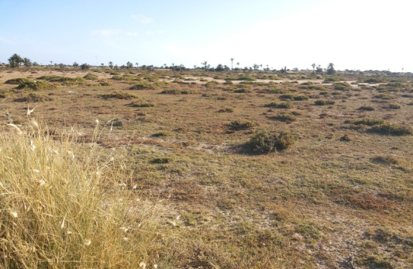
Effects of year on growth and carcass performances of lambs reared on saline pasture
 | 2018 | 2019 | P values
Number of lambs | 20 | 15
Stocking rate (lambs/ha) | 3.3 | 3.7
Initial body weight (kg) | 25.60 | 21.00 | 0.001
Average daily gain (g/d) | 89 | 177 | <0.0001
Slaughter weight (kg) | 31.00 | 29.25 | 0.128
Cold carcass weight (kg) | 14.54 | 13.24 | 0.082
Commercial yield (%) | 46.87 | 45.34 | 0.407
Conclusion
Pasture yield Rainfall
Growth performances
Carcass traits
Current measurements must be extended for longer periods.

